Slide 1

Tips for Effective Communication

Slide 2


Important points to improve communication skills
Communication Skill = 10% words +30%(tone+ tuning) + 60% . body Language
Confidence
Enthusiasm
Clear Objective
Self Prepared Scripts
Effective Start
Clear voice
Speed
Logical Presentation
Effective End
Subjective Matter

Slide 3

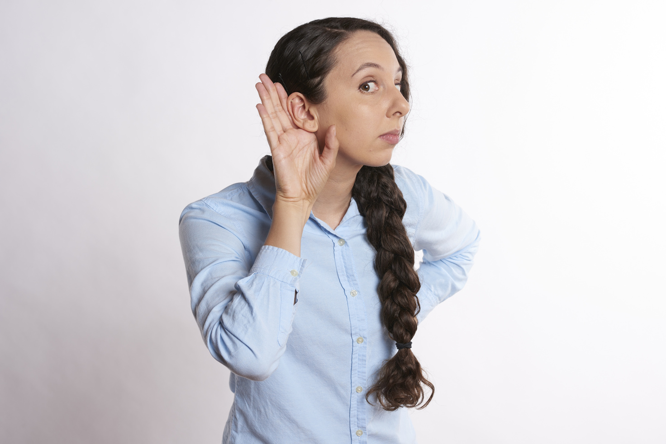



Speaking
Writing
Listening
Reading
Non-verbal communication

Slide 4
Effective Speaking
Classified as -
Daily Speaking
Public Speaking

Slide 5
Daily Speaking
Public Speaking
Remember the person
Eye contact
Remain Normal
Presentation
Visual Aid
Delivery

Slide 6

Effective Writing
Visualize your audience
Deliver the content directly
Create a outline or prepare notes
Convey clearly your ideas

Slide 7

Effective Listening
Avoid distraction
Keep an open mind
Hold your questions and vision
Make meaningful notes

Slide 8

Effective Reading
Ensure proper lightning
Read twice for better understanding
Use dictionary to find the meanings

Slide 9
Non-Verbal Communication
Facial expression
Attitudes and postures
Eye contact

Slide 10








Thank you

